Slide 1
How-to guide.
Detailed summary report.
Download and print.
Exclusions and endorsements.

Slide 2
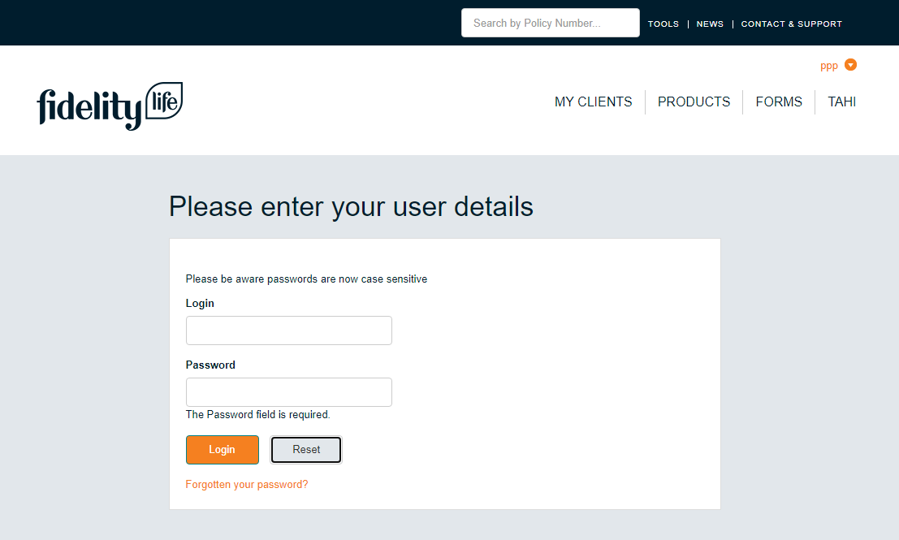
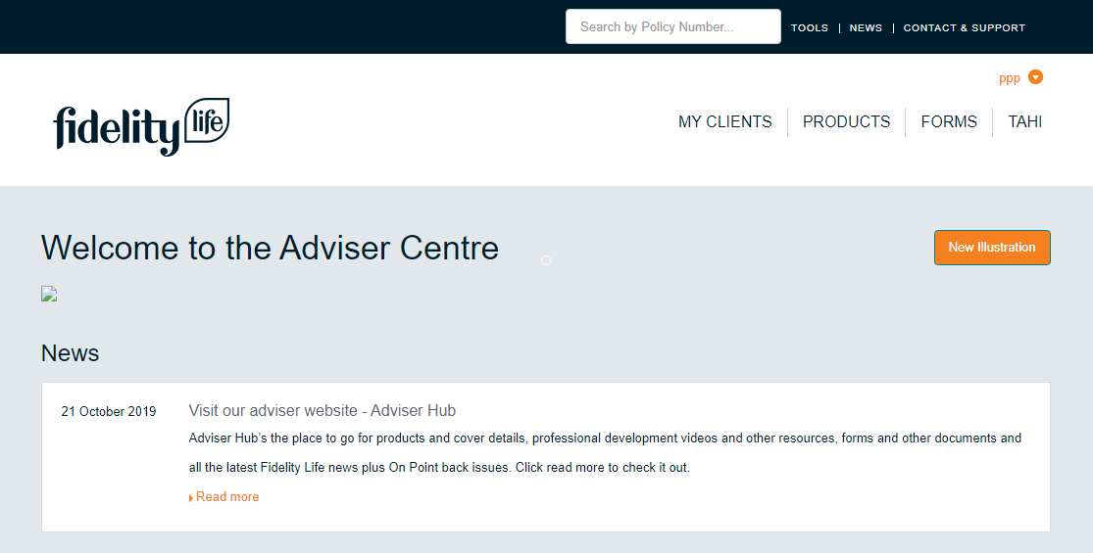
1
Log into Adviser Centre.
Log into Adviser Centre with your usual credentials.
Click the ‘Tahi’ tab and ‘Detailed Policy Summaries’.
Click ‘Login’.

Slide 3
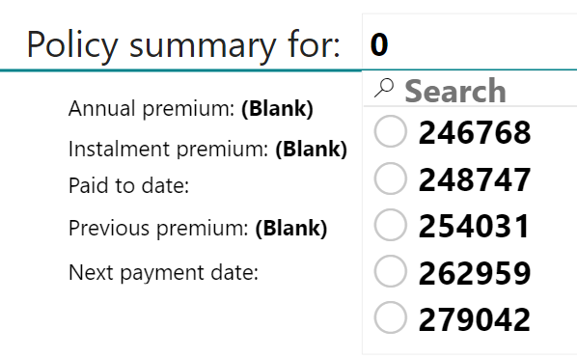
2
Search for a customer policy.
Search for the relevant policy summary by typing in a policy number or clicking on a policy number that is displayed.
Click the ‘Print’ button.
The relevant policy information will display.

Slide 4
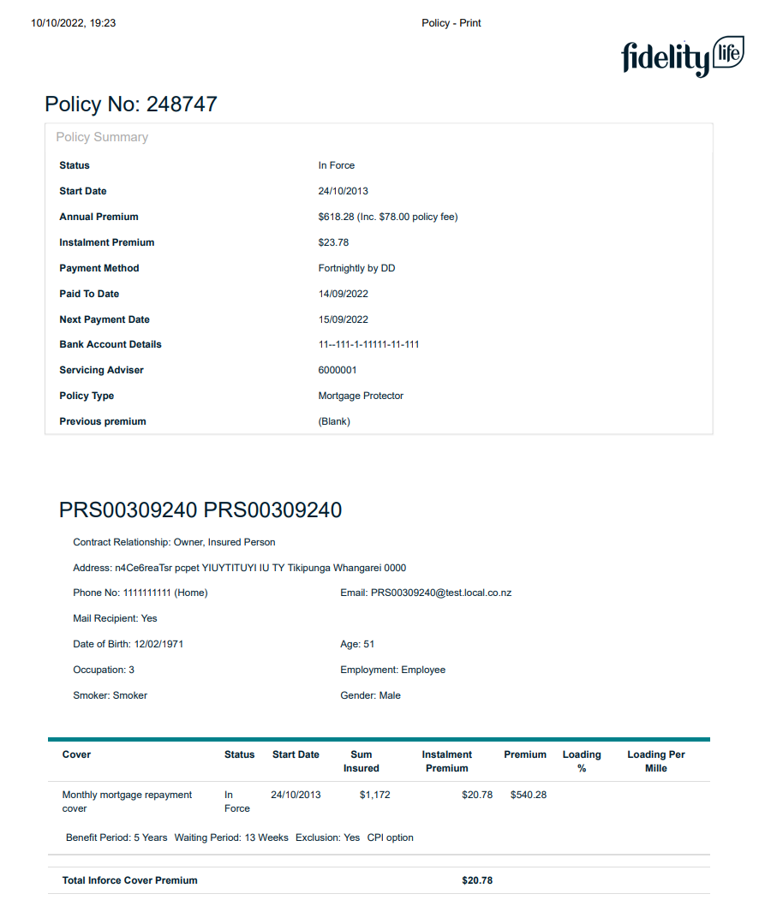
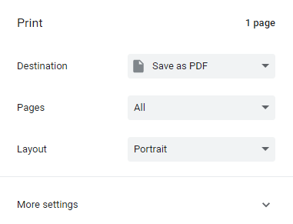
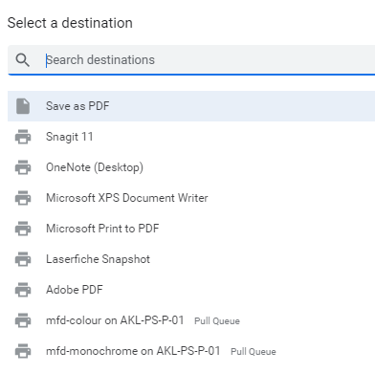
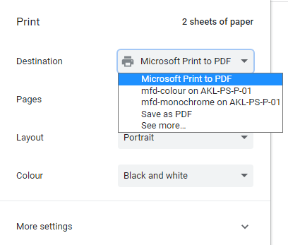
3
Download or print.
A copy of the policy report will display (note: only In Force covers currently on Tahi will be included in the download.)
Click the ‘See more’ button to select the option you prefer.
Click on the ‘Save as PDF’ button for further options. You can also select the layout and pages to save / print.
You can then click ‘Save’ or “Print’ in the bottom right-hand corner.

Slide 5
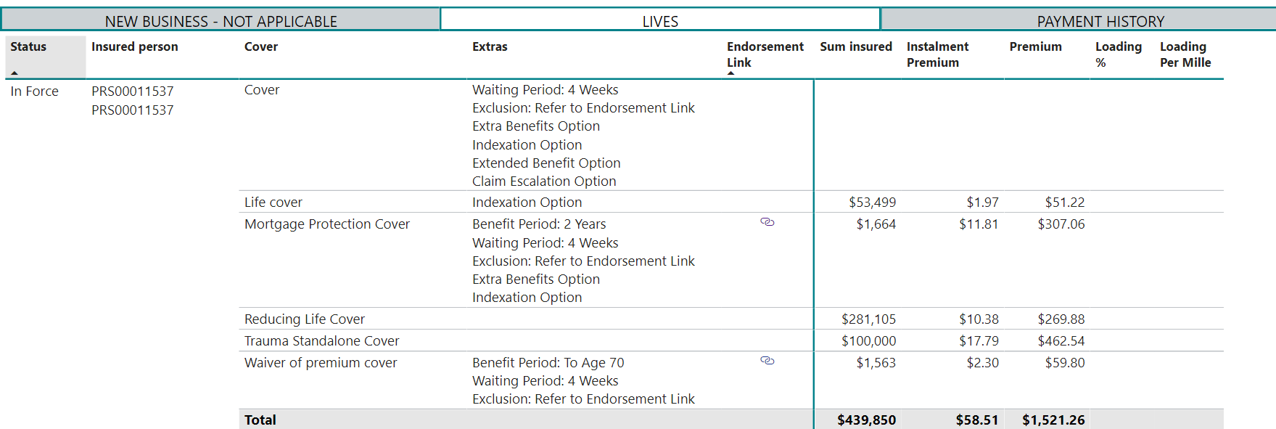
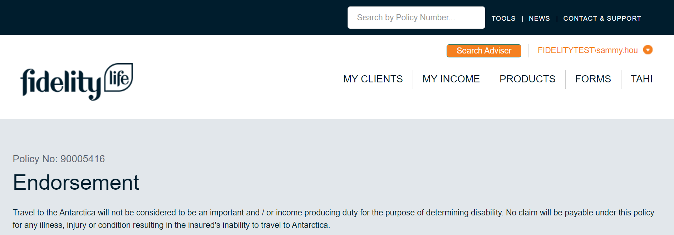
4
Review endorsements and exclusions.
If there are endorsements or exclusions, a small ‘link’ button will appear in the ‘Endorsement Link’ field.
A new webpage will open, displaying the endorsement information.
Full endorsement and exclusion information will only display for policies issued in Tahi. Polices that have migrated from PCMS will display a message for advisers to contact Customer Services.
Click the ‘link’ button to view endorsement information.

Slide 6
Where to go for support.
Email us:
Adviser care: advisercare@fidelitylife.co.nz
Give us a call:
Fidelity Life policies: 0800 88 22 88
Fidelity Life policies (international): +64 (0)9 373 4914

